Slide 1

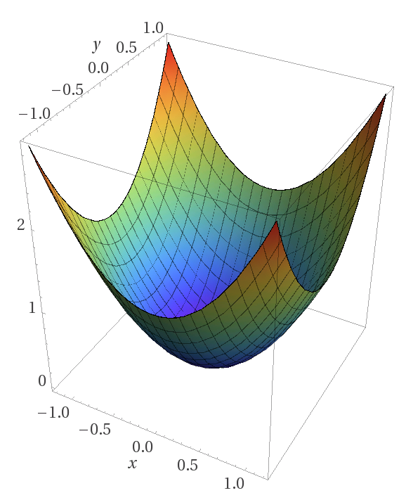
PhD Pre-Confirmation Meeting
Day Month 2019
Peter Donnelly
peter.donnelly@petermac.org
Illustrating Convex Optimization, the mathematical basis of neural networks
Image: https://www.matroid.com/blog/post/the-hard-thing-about-deep-learning
Notes:
This is a talk about what we are doing at Peter Mac to move high throughput sequencing into the clinical pathology area.
We’ve built a web application called Path-OS (for pathology operating system) to manage our variants.
In contrast to a lot of the talks in this forum it’s a bit more focused on software engineering than bioinformatics.

Slide 2

“Improving Classification of T-Cell Lymphomas By Applying Machine Learning to Dual Heterogeneous Data Sources"

Slide 3
Motivation
Even experienced pathologists find it challenging to differentiate some lymphomas by morphology alone. Inter-pathologist variability is very high for some subtypes. Peripheral T-cell Lymphomas (PTCL) as a particular example
Gene expression testing (Microarrays, RNASeq, Nanostring) will become a mainstream clinical test for cancer patients
Ultimately, manual labelling is not sustainable due to the enormous volumes of images and data now being generated

Slide 4
Machine Learning ?
Machine Learning has shown early promise in successfully classifying cancers from histopathology images
But most ML efforts in histopathology have tended to focus on low hanging fruit, viz
  easier to classify cancers
  opportunistically where good labelled data happens to be available
The easiest way of obtaining good results with ML is to use good quality, consistently labelled training data, but such data is inevitably scarce in the domains of interest
  There are ML techniques which can amplify the effectiveness of less than perfect data, but these are only occasionally used. In particular:
    Multi-modal learning; which allows learning from multiple heterogeneous data types simultanesously (e.g. Image + gene expression data)
    Multiple Instance Learning; which uses aggregate labelling of training data. (e.g. single end diagnosis as the label for each of thousands of tiles from a WSI)

Slide 5
Proposed Thesis Title and Objective
Improving Classification of T-Cell Lymphomas By Applying Machine Learning to Dual Heterogeneous Data Sources
The key aspect is the use of both slide images and genomic data to improve classification of poorly differentiated cancer types
The selection and/or development of processes, toolchains and models processing will be a major element of the PhD
Wednesday, 2 October 2019
HUB Path-OS
Notes:
So these are some of the issues with most current molecular pathology services.
Things are likely to get more complex as more is learned about disease pathology and epigenetics gets used.
It really comes down to a data filtering exercise, processing the variants and evidence in a clinically usable timeframe.

Slide 6
Questions to be Tackled
?
Might a suitably selected and appropriately applied Machine Learning technique distinguish cancer types which human pathologists find challenging to visually distinguish (for example, Non-Hodgkins T-cell lymphomas)?
Might training an ML with two heterogeneous data types (specifically, morphology + gene expression data):
  yield improved cancer classification outcomes compared to using either alone?
  reduce the number of labelled examples necessary to achieve a similar level of classification outcome, as measured by some suitable metric, compared to using image data alone?
What processes, toolchains and machine learning models are best be suited to achieving the above ?

Slide 7
Time Order
Aim 1
Aim 2
Aim 3
By iteratively developing and implementing one or more Machine Learning systems ...
Test and quantify and discuss the efficacy of ML classification of T-Cell Lymphomas:
using WSI image data alone & gene expression data alone (RNASeq or Nanostring gene expression data) to a
using both WSI image data and gene expression data (RNASeq or Nanostring gene expression data)
Using publicy accessible WSI datasets (esp. TCGA and Camelyon)
Using PMCC clinical data
Quantify the extent (if any) to which using two data types reduces the number of training examples required compared to using image data alone
Describe suitable toolchains and models used the achieve the above; and make these freely available to the broader research community via github or docker hub or similar

Slide 8
Aims
Aim 1
Aim 2
Aim 3
By iteratively developing and implementing one or more Machine Learning systems ...
… Test and quantify and discuss the efficacy of ML classification of T-Cell Lymphomas:
Primary Objective
Primary Objective
… using WSI image data alone and gene expression data alone (RNASeq or Nanostring gene expression data)
… using both WSI image data and gene expression data (RNASeq or Nanostring gene expression data)
… with publicy available WSI datasets (esp. TCGA and Camelyon)or PMCC B Cell project data to establish baseline learning model
… with PMCC clinical data
Document the toolchains and models used in pursuit of the above; and make these freely available to the broader research community via github or docker hub or similar
Secondary Objective
Quantify the extent (if any) to which using two data modes reduces the number of training examples required compared to image data alone
Preferred outcome
Preferred outcome
Preferred outcome
ESTABLISH
BASELINE TOOLCHAIN
TEST THE ‘DUAL DATA’
HYPOTHESIS
TEST HYPOTHESIS WITH CLINICAL DATA
ESTABLISH
BASELINE MODEL

Slide 9
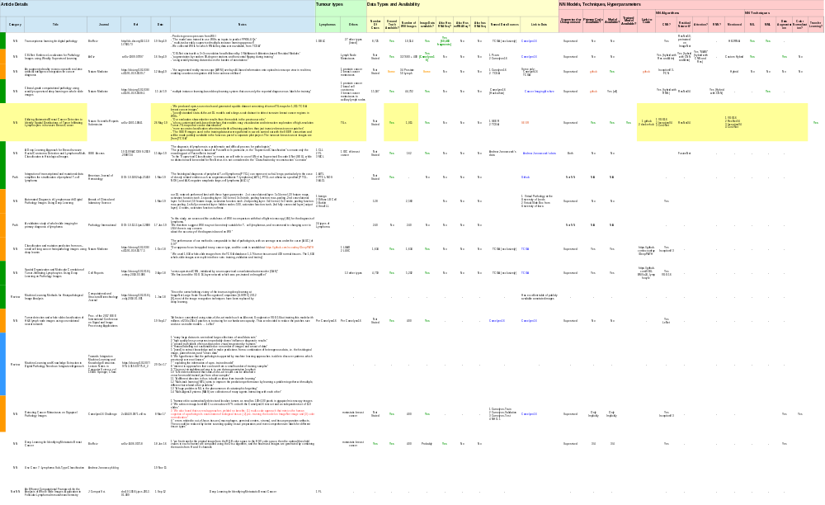
Structured Review of Applicable ML Papers

Slide 10
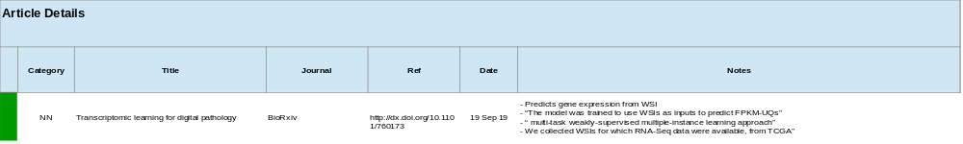
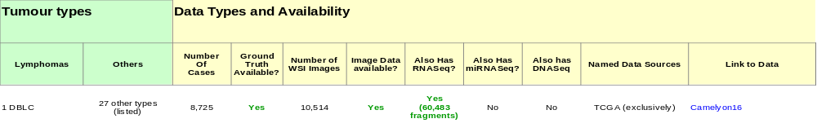
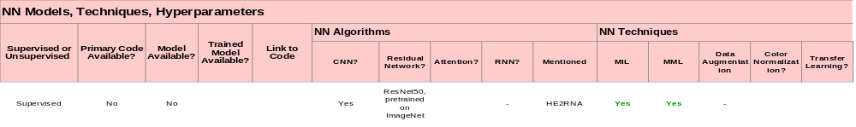
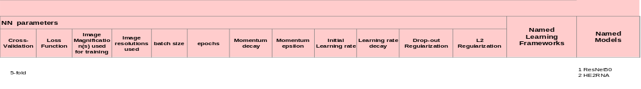
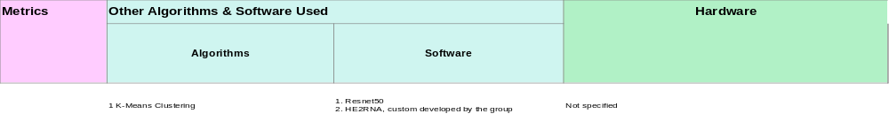
Eg. ‘Transcriptomic learning for digital pathology’

Slide 11
Motivating Papers
‘Transcriptomic Learning for Digital Pathology’
  http://dx.doi.org/10.1101/760173 (Sep 2019)
  Summary: Predicts gene expression from WSI: WSIs as inputs to predict FPKM-Uqs *
  Scope: Pan-Cancer (28 types)
  Data: WSIs from TCGA for which RNA-Seq data is available (9,000 cases, 11,000 images)*
  Technique: Uses both Multi-task learning and multiple-instance learning
  Outcomes: Modest results, but the surprising thing is that it works at all. Interest is more in the data and the techniques however
  Negatives: uses highly customized NN model for which code is not available, so not verifiable
‘A Deep Learning Approach for Breast Invasive Ductal Carcinoma Detection and Lymphoma Multi-Classification in Histological Images’
  https://doi.org/10.1038/s41591-018-0177-5 (Apr 2019)
  Summary: two aspects: (I) detection of DCD (ii) classification of three kinds of Lymphoma *
  Scope: Classification of 3 kinds of Lyphoma ; detection of invasive ductal carcinoma
  Data: Publicly accessible TCGA obtained from Andrew Janowczwk’s web site (162 + 374 images)
  Technique: Encoding stage of a convolutional Autoencoder, but with the decoding stage trained in a supervised manner
  Outcome: (I) Claimed state of art for ML Lymphoma classification (ii) claimed pan-cancer” (iii) “We have shown that the encoder of the FusionNet AE be adapted for cancer detection and the classification of histological images
  Negatives: (i) Accuracy isn’t a very good metric here: “Accuracy works best if false positives and false negatives have similar costs”; (ii) Drastic down-sampling of image size in Lymphoma case is worrying (iii) model only described, not made available
‘Clinical-grade computational pathology using weakly supervised deep learning on whole slide images’
  https://doi.org/10.1038/s41591-019-0508-1 (Jul 2019)
  Summary: “multiple instance learning-based deep learning system that uses only the reported diagnoses as labels for training”
  Scope: three cancer types: prostate, BCC, breast cancer metastases in lymph nodes
  Data: Camelyon16 dataset (15,000 cases, 44,000 WSIs) *
  Techniques: (I) Resnet-34 (ii) Multiple Instance Learning (diagnostic-label for all tiles rather than hand annotation of tiles) *
  Outcomes: (I) claimed ‘Clinical Grade’ results * (ii) claimed Pan-cancer. One model to classify multiple cancer types from H&E WSIs
  Negatives: no obvious negatives
‘Utilizing Automated Breast Cancer Detection to Identify Spatial Distributions of Tumor Infiltrating Lymphocytes in Invasive Breast Cancer’
  ArXiv:1905.10841 (May 2019)
  Summary: Using standard contemporary DL models and a large-scale dataset to detect invasive breast cancer regions in WSIs” *
  Scope: TILs
  Data: Trained on 198 SEER WSIs; tested on 1,015 TCGA WSIs
  Techniques: highly mainstream CNNs, viz: VGG16, Resnet-34, InceptionV3 *
  Outcomes: (I) respectable results from applying straightforward NNs to WSI images (ii) Illustrating a system (‘pipeline’) level approach (“QUIP”) *
  Negatives: no obvious negatives
‘Classification and Mutation Prediction from Non-Small Cell Lung Cancer Histopathology Images using Deep Learning’
  Illustrating a ‘low hanging fruit’ application of ML to WSI Image Classification
  Showing respectable results from an ‘off the shelf’ ML model (Google Inception v3)
‘Machine Learning and Knowledge Extraction in Digital Pathology Needs an Integrative Approach’ [ref]
  Suggesting that a Multi-Model approach generally improve ML effectiveness over one data type

Slide 12

Tools and Methods
Machine Learning Models:
  Deep Convolutional Neural Networks, especially:
    VGG16
    InceptionV4
    ResNet34/50
  LSTM Recurrent Neural Networks
  Transformer Networks
    ‘Tensor to Tensor’ (T2T)
  Hybrids
    Custom combinations of the above to cater for dual data types (image + sequence)
Techniques:
  Contemporary Neural Networks (supervised learning)
  Multi-modal Learning (orthogonal data types)
  Multiple Instance Learning
  Data Sharding
  N-Fold cross validation; ‘One-at-a time’ cross validation
Metrics
  Performance against held-back (never seen) examples
  Generalization across datasets from different processes and institutions
  Number of weights used in models
  Training times
Statistics
  Precision/Recall/F-score
  ROC/AUC (Receiver Operating Characteristic/Area Under Curve)

Slide 14
Issues, Risks and Ameliorations
Availability of sufficient quantities of suitable labelled data to use for training
  Permissions
  Quality of labels (classifications)
  Volume
It is unknown whether an ML algorithm will be able to extract sufficient signal from morphological features to combine with gene expression data

Slide 15
Draft Chapter Headings

Slide 16
My Work to Date
Acquiring Relevant Domain Knowledge
  Cell biology and cancer genomics (reading and lectures)
  Cancer Pathology Processes
    Learing about PMCC roles, workflows and systems
    Gene Sequencing & Curation (reading, interviews, lectures)
  Histopathology (reading and lectures)
Establishing and methodically using reference management system (Zotero based)
ML Infrastructure
  Home Environment: for learning and rapid model development / tweaking
  AWS (Cloud) P3 Spot Instances: for large scale learning
  PMCC ML facility
Deep Dives into relevant contemporary ML algorithms, models, techniques including
  Convolutional Neural Networks
  Long Short Term Memory (LSTM) RNN networks and Attention Models
  Transformer Models, in particular Google Brain’s Tensor2Tensor implementation
  Word Embedding (eg. Word2Vec, Glove …)
Trying out and existing relevant ML applications
  Text Summarization using LSTM (model: ‘Long-Summarization’)
  Analysis of cancer pathology samples using CNN (‘QUIP’)
  Text2Text applications using Transformer models (Google Brain‘Tensor2Tensor)
Locating and experimenting with useful tools and datasets
  digitally accessible portions of the literature (PubMed Central)
  well known & best practice datasets (e.g. disease, gene and drug ontologies)…
Circumscribing and homing in on a tractable problem (subsequent slides)
  Relevant, Achievable, Interesting, Reasonable likelihood of success
Wednesday, 2 October 2019
HUB Path-OS
Notes:
So these are some of the issues with most current molecular pathology services.
Things are likely to get more complex as more is learned about disease pathology and epigenetics gets used.
It really comes down to a data filtering exercise, processing the variants and evidence in a clinically usable timeframe.

Slide 17
Slide bucket

Slide 18
Context and Motivation
Machine Learning making explosive progress since about 2012
  A Key Event: AlexNet 2012
  Why? Alignment of planets
    Hardware power & suitability of GPUs for parallelizing ML processing (Linear Algebra)
    Refinements to longstanding algoirthms eg. ReLu, Regularization …
ML is emerging as universal tool
  Every discipline / profession / research field is looking to see what ML might to for them
  Including essentially every medical field …
    Used clinically in only a small number of applications – e.g. detecting glaucoma
  … and oncology in particular
    But still very much pre-clinical
ML holds great promise for oncology
  Many important oncology problems are classification problems, and ML is good at this
  Current practice are highly manual and time consuming and require much judgment
  ML models are accretive & once developed can be disseminated at very low cost
But there are significant challenges
  Not yet known which applications are a good match
  Lack of quality labeled data is a hindrance
  Skill chasm: ML researchers know little about oncology and vice-versa
    Emergence of bioinformatics as a specialized category
    Modern genomics brought IT and big data skills with it, so base of expertise exists
Wednesday, 2 October 2019
HUB Path-OS
Notes:
So these are some of the issues with most current molecular pathology services.
Things are likely to get more complex as more is learned about disease pathology and epigenetics gets used.
It really comes down to a data filtering exercise, processing the variants and evidence in a clinically usable timeframe.

Slide 19
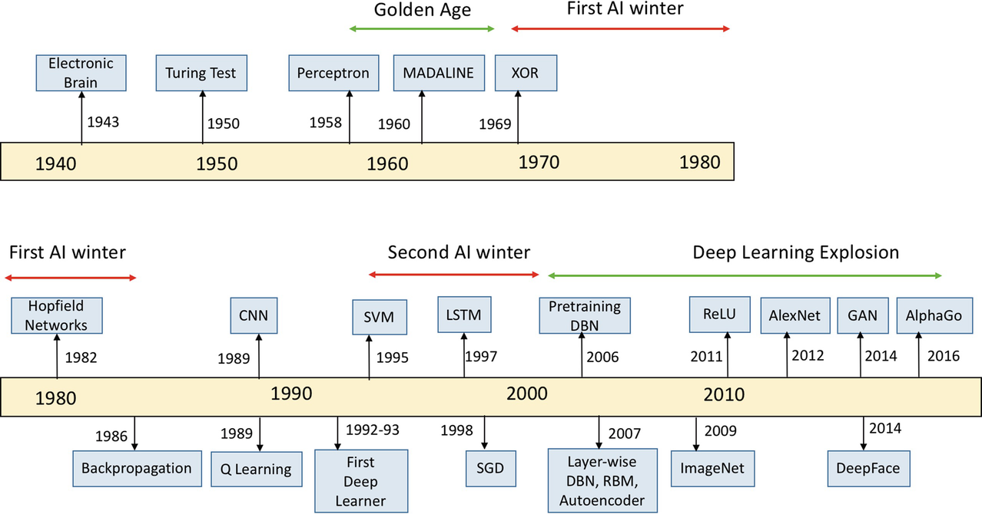
Capsule History of AI
Source: Kamath U., Liu J., Whitaker J. (2019) Introduction. In: Deep Learning for NLP and Speech Recognition. Springer.

Slide 20
Opportunity Areas & Assessments
Automated Histopathology Sample Analysis tool
  How: Using CNN or Captioning Model (Image to Text)
  Assessed Level of Innovation: Low if CNN; High if Captioning
  Notional Difficulty: Medium if CNN based; Medium if Captioning based
  Likelihood of Successful Outcome: Medium if CNN based; Unknown if Captioning based
Literature Summarizing Tool for Curators
  How: Using either LSTM or Transformer
  Assessed Level of Innovation: Low - Medium
  Notional Difficulty: High
  Likelihood of Successful Outcome: Low - Medium
Knowledge Extraction from the Literature
  How: Using techniques such as …
  Assessed Level of Innovation: Medium
  Notional Difficulty: Medium
  Likelihood of Successful Outcome: Medium
End-to-End Gene Curation using Captioning Model
  How: Captioning Model (Gene Sequence to Text)
  Assessed Level of Innovation: High
  Notional Difficulty: Unknown but probably High
  Likelihood of Successful Outcome: Unknown
Cancer Classification using orthogonal data sources (eg. gene sequence + blood test results)
  How: Multi-mode NN model (eg. CNN + LSTM)
  Assessed Level of Innovation: Medium
  Degree of Difficulty: Med-High
  Likelihood of Successful Outcome: Unknown
Wednesday, 2 October 2019
HUB Path-OS
Notes:
So these are some of the issues with most current molecular pathology services.
Things are likely to get more complex as more is learned about disease pathology and epigenetics gets used.
It really comes down to a data filtering exercise, processing the variants and evidence in a clinically usable timeframe.

Slide 21
Notes:
Clinical aims as opposed to theoretical aims
Validate that we can get data, or alternatively how can we get the data (who do we have to hassle)
Frame it very narrowly

